Slide 1
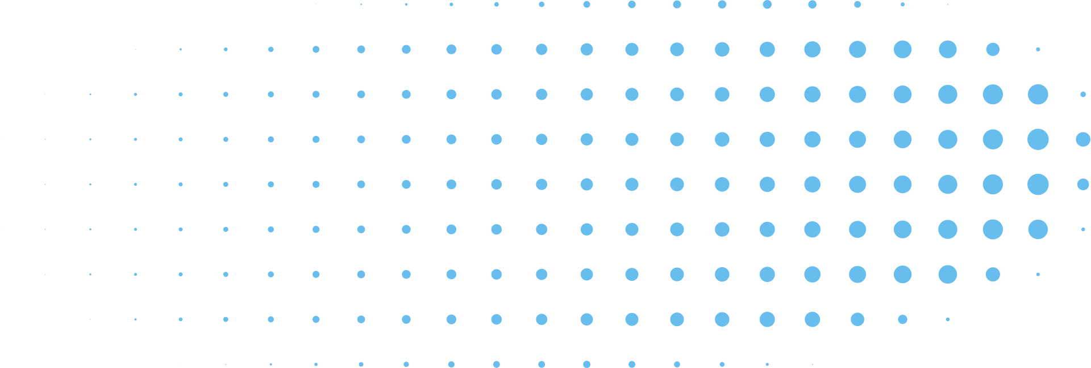
PAWSPHERE
AN ANIMAL WELFARE PLATFORM FOR RESCUE, ADOPTION AND CARE MANAGEMENT
Daffodil International University | Spring 2026
1

Slide 2

65_A, GROUP-02
Presented To
Presented By
Shisita Sarkar Setu (232-15-762)
Shafin Ahmed (232-15-184)
Sakib Ahmed (232-15-085)
Dr. Abdus Sattar
Associate Professor & Director
Department of CSE
Daffodil International University
Daffodil International University | 2026
2

Slide 3
TOPICS
Story (Description)
Introduction
Objectives
Related Works
Software Requirements Specification
a. Model Selection
b. Functional & Non-Functional Requirements
c. Use Case Diagram
d. Use Case Description
e. Activity Diagram
f. Sequence Diagram
g. Class Diagram
Graphical User Interface (Hi-Fi or Low-Fi)
Project Estimation and Planning
Hardware and Software Requirements
Ethical, Legal, and Security Issues
Limitations and Challenges
Team Collaboration and Time Management
Acknowledgement
Daffodil International University | 2026
3

Slide 4
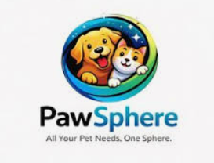
WHAT IS PAWSPHERE?
Animal Welfare Platform
Rescue
Adoption
Veterinary Care
Community Network
👉 All-in-one system
4
Photos retrieved from Google Gemini

Slide 5
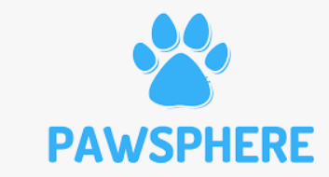
WHY IS IT NEEDED?
Injured stray animals
No quick response system
Lack of coordination
People don’t know how to help
👉 Problem = No unified platform
5
Photos retrieved from Google

Slide 6
Why Our Approach?
Centralized platform
Real-time rescue system
Smart map tracking
AI-based support (simulated)
👉 Fast + Connected + Smart
6

Slide 7
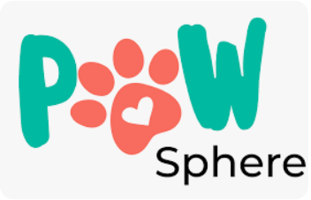
Impact & Vision
Faster rescue response
More successful adoptions
Strong volunteer network
Vision:
“Technology + Humanity”
7

Slide 8




Related Works
Most systems are single-purpose and fragmented
Petfinder → only adoption-focused
PETA & Animal Welfare Institute → awareness only
ShelterLUV → shelter management only
No system supports real-time rescue + full ecosystem
8
Photos retrieved from Google

Slide 9
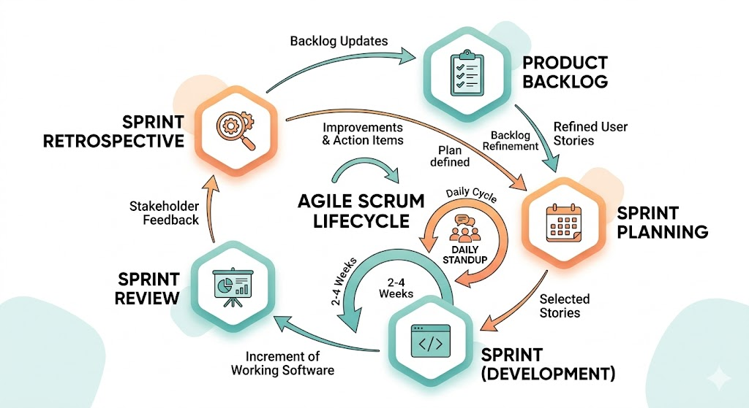
Model Selection (Agile – Scrum)
Used Agile (Scrum) model
Sprint-based development
Supports modular features
Easy to update & improve
Fast testing & delivery
Best for complex system
9
Photos retrieved from Google Gemini

Slide 10
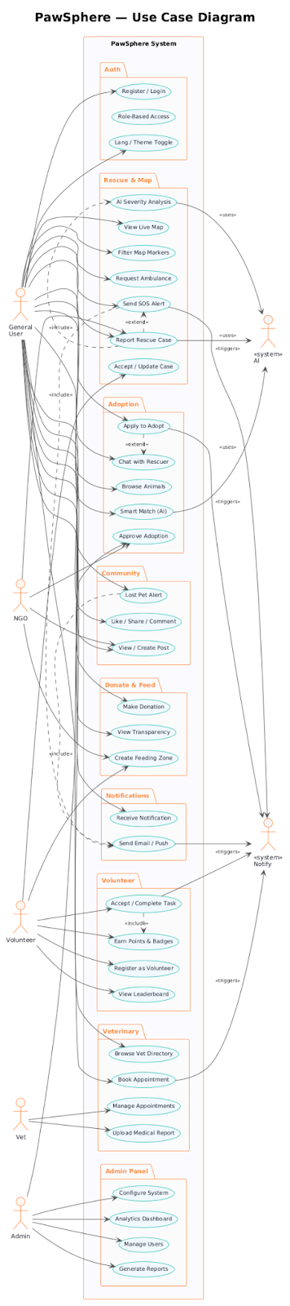
Use Case Diagram
Click Here For Better View
Part 1
Part 2
Part 3
Photo credit Plant UML

Slide 11
Use Case Description
Register Account
Actor: General User, Volunteer, Vet, NGO
Type: Primary and Essential
View Animal Profile
Actor: General User
Type: Secondary and Essential

Slide 12
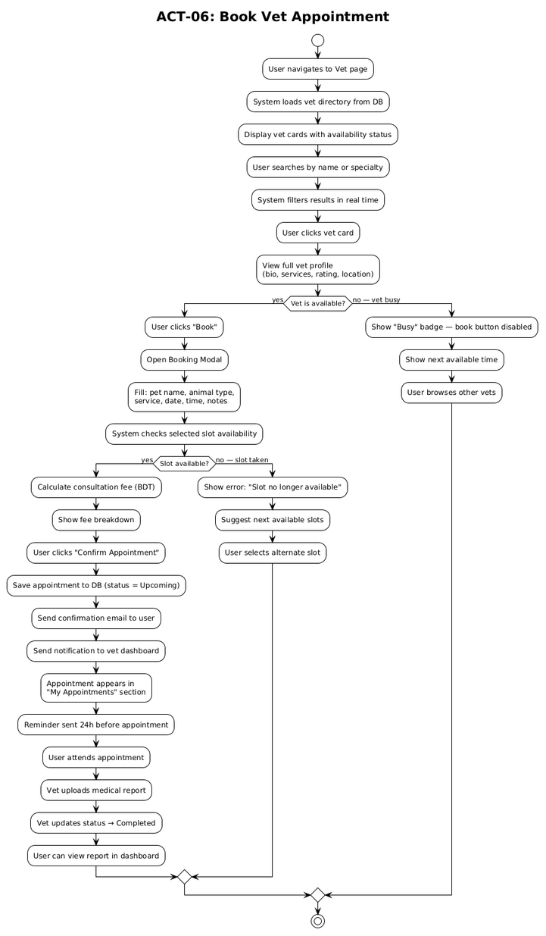
Activity Diagram
-Help us to understand how system flow
Photo credit Plant UML

Slide 13
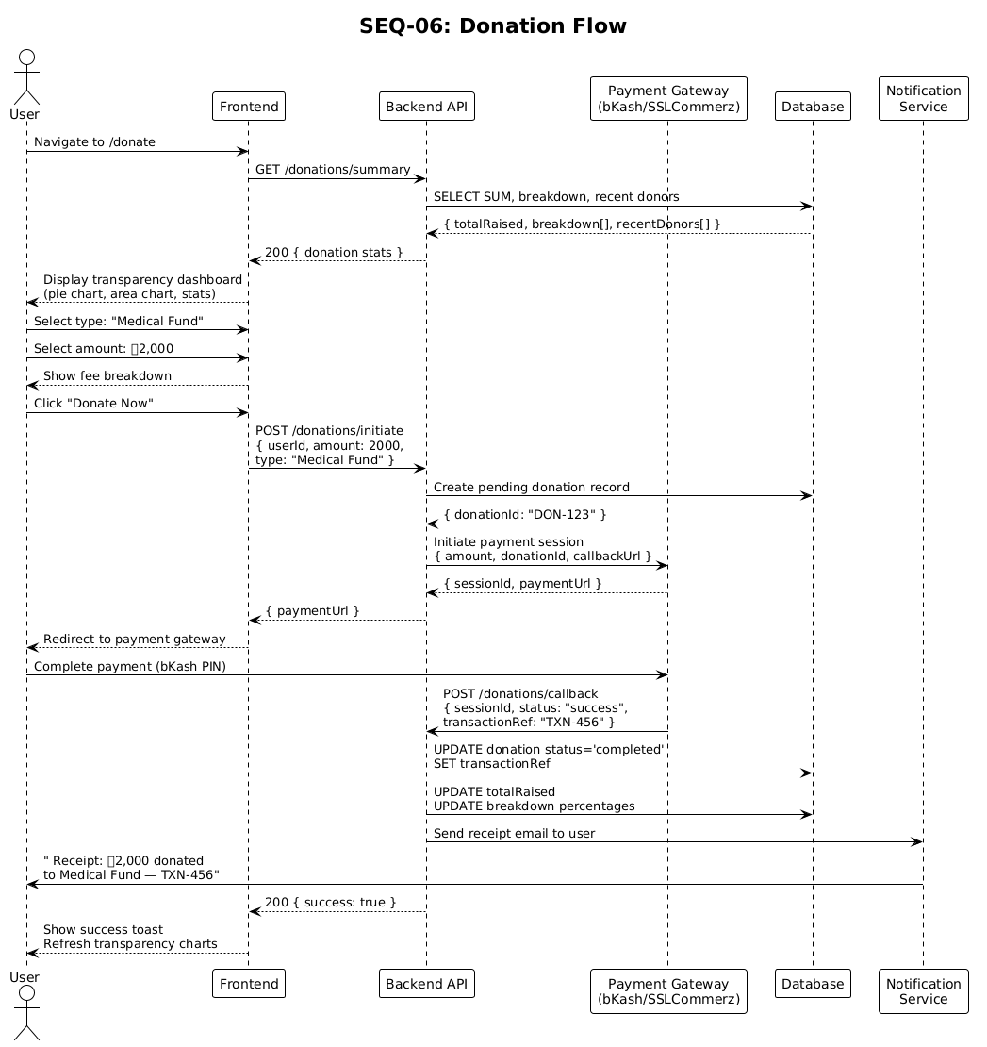
Sequence Diagram
Different parts of the system → communicates with each others
Photo credit Plant UML

Slide 14
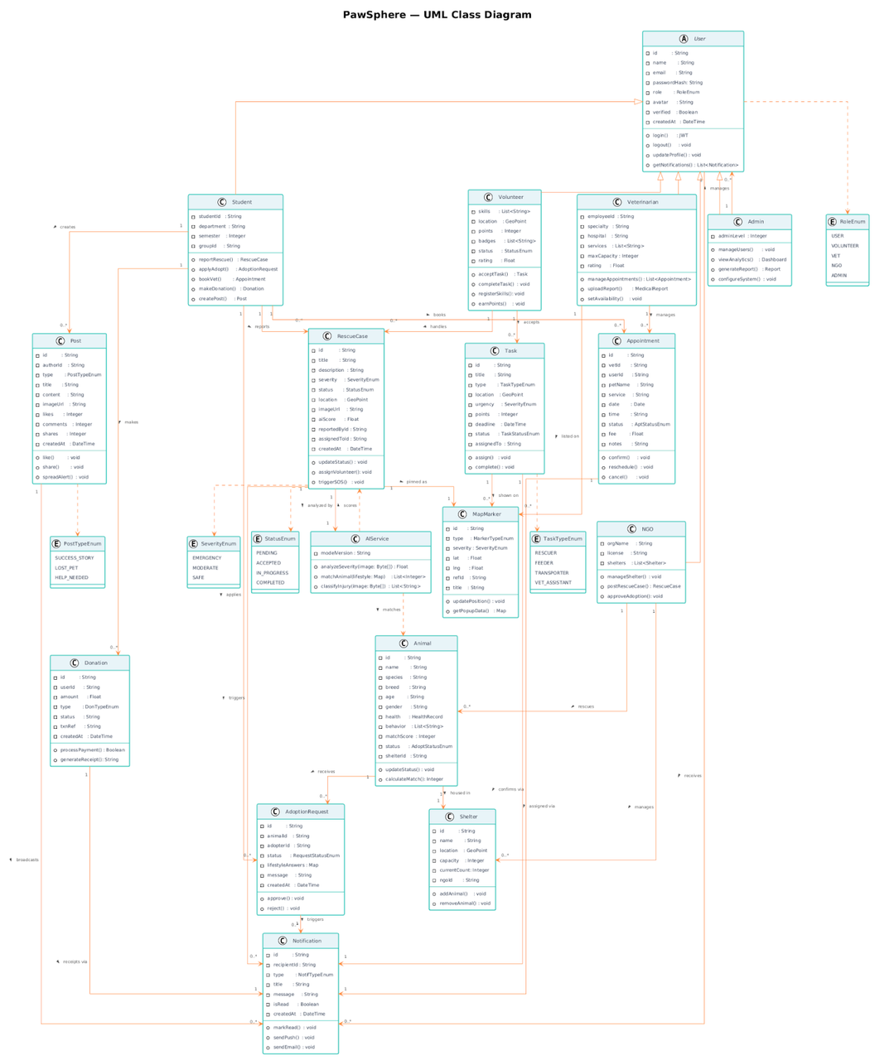
Class Diagram
-Structure of the system
-Understand how the system is built internally
Click Here For Better View
Photo credit Plant UML

Slide 15
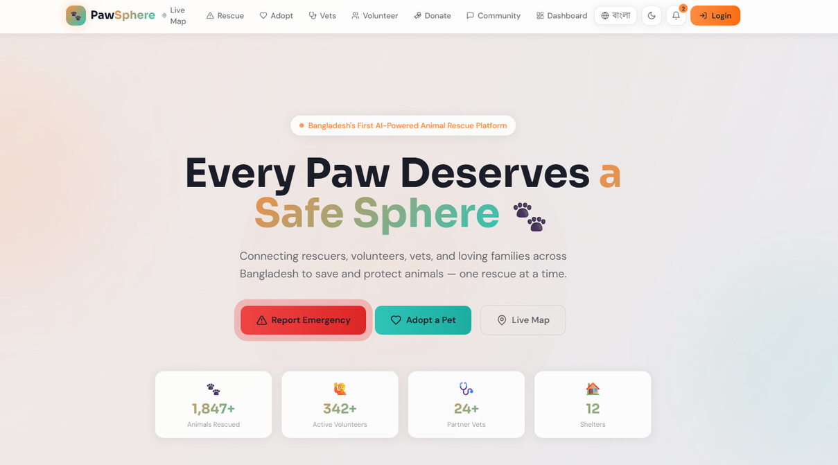
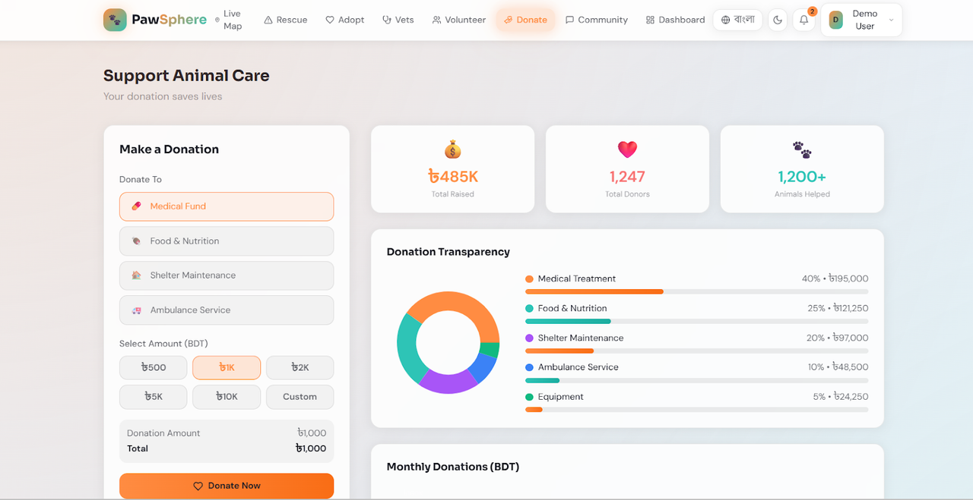
GUI (Graphical User Interface)
Opening Page of Website
Donation page
Photo credit Google Gemini

Slide 16
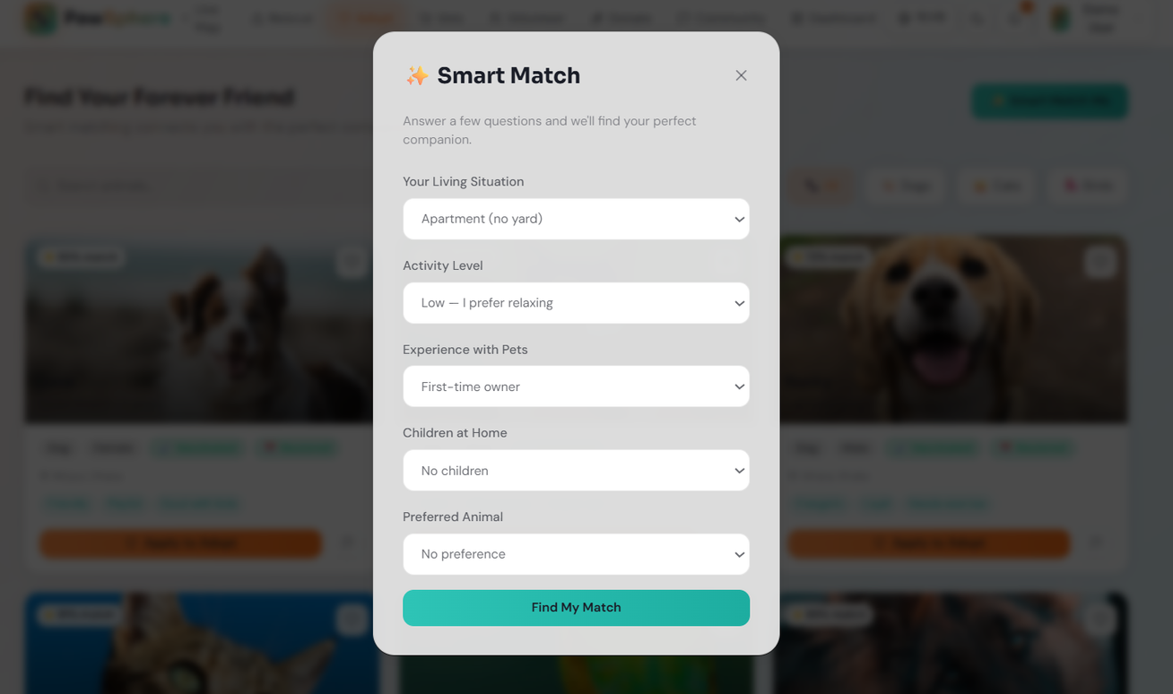
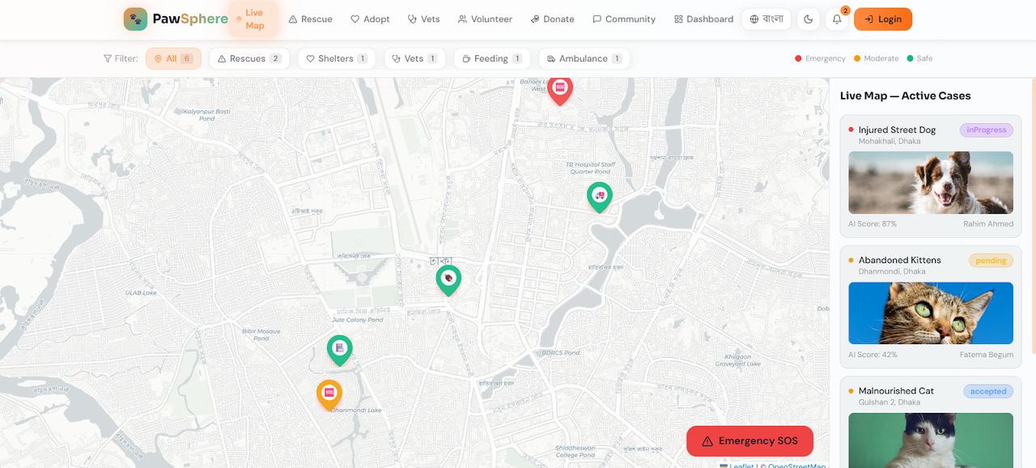
GUI (Graphical User Interface)
Map & Smart Match
Photo credit Google Gemini

Slide 17
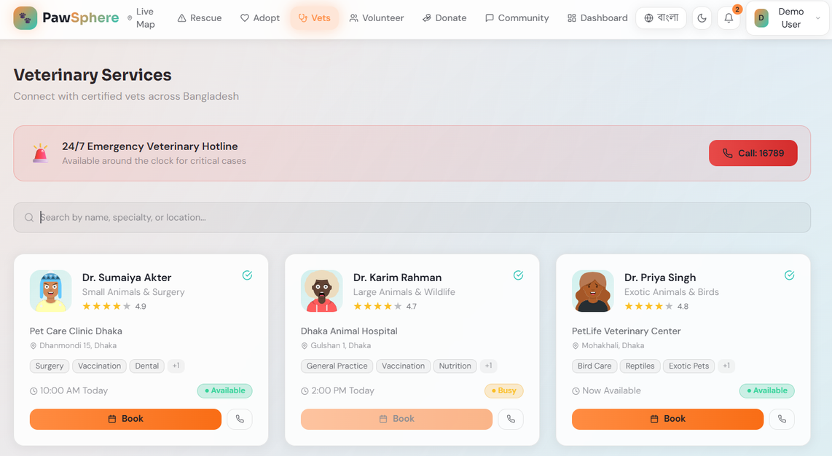
GUI (Graphical User Interface)
Support Animal Care & Veterinary Services
Photo credit Google Gemini

Slide 18
Responsibilities
🔹 Functional Requirements
User auth & roles
Rescue & SOS system
Smart map view
Adoption & vet services
Community & donations
🔹 Non-Functional Requirements
Fast performance
Easy to use (responsive)
Secure system
Reliable & always available
Scalable & maintainable
Photos retrieved from Google Gemini
18

Slide 19
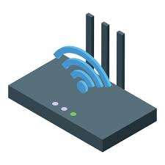


Hardware and Software Requirements
🔹 Hardware Requirements
i5 / Ryzen 5, 8GB RAM
SSD storage
Stable internet
Cloud server (AWS/Vercel)
Scalable resources
🔹 Software Requirements
Next.js + React
Node.js + Express
PostgreSQL / MongoDB
Git, VS Code, Postman
Cloud services & APIs
19
Photos retrieved from Google

Slide 20
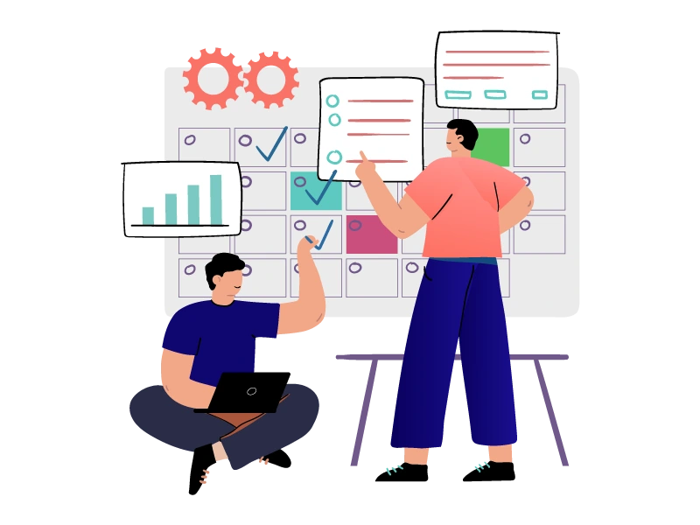
Project Planning & Estimation:
🔹 Project Planning Overview
13 modules, multi-role system
AI + real-time features
Full-stack architecture
Medium–large complexity
Responsive web platform
🔹 Effort Estimation
Total: 50–70 days
High modules: 7–10 days
Medium modules: 4–6 days
Low modules: 2–3 days
Balanced workload
Photos retrieved from Google Gemini
20

Slide 21

Security & Ethical Issues:
🔹 Ethical Issues
User data privacy & consent
AI used responsibly (no misleading)
Fair access (Bangla + simple UI)
Prevent animal abuse/misuse
Verified users (NGO, vet)
🔹 Security Issues
JWT auth & role control
Password hashing (bcrypt)
Secure APIs & validation
Encrypted data (HTTPS)
Safe payments (no data stored)
Photos retrieved from Google Gemini
21

Slide 22
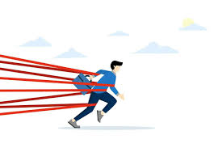

Limitations and Challenges
🔹 Limitations
Mock AI (no real ML)
Partial backend integration
No real payment system
No offline/SMS support
Map & real-time limitations
🔹 Challenges
Scalability & performance
Complex UI (many modules)
Multi-role management
Tech integration issues
Time constraints
Photo retrieved from Google
22

Slide 23
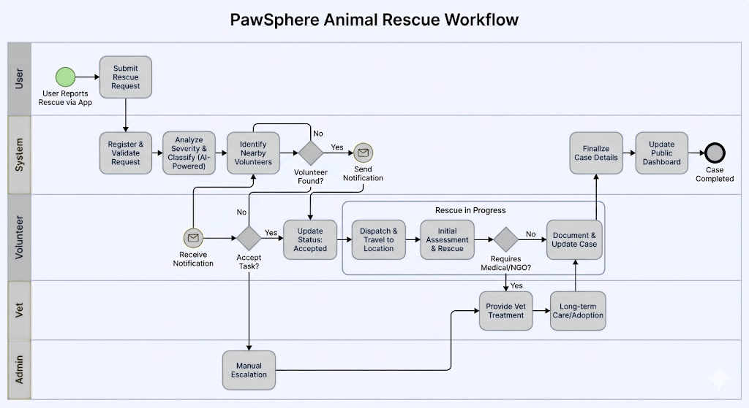
Workflow Example
“It illustrates interactions between user, system, volunteer, and vet with decision points and real-time updates.”
Photos retrieved from Google Gemini
23

Slide 24
PawSphere is a scalable animal welfare platform with rescue, adoption, vet, and donation systems.
It demonstrates real-world problem solving using modern web technologies and provides a strong foundation for future AI-based enhancements.
Conclusion
24

Slide 25
QUESTION?
25

Slide 26
ACKNOWLEDGEMENT
We thank Dr. Abdus Sattar for his guidance and support. We also appreciate our team and institution for their cooperation.
26

Slide 27
THANK YOU
27

